Slide 1

Decoding Consumer Sentiment: NLP and Descriptive Analysis of Tablet Sales Reviews
Name: Abhishek Paul Kastala
Student ID: 15048897
Module Name: 7151CEM: Computing Individual Research Project
Date: April 3, 2025

Slide 2
Overview:
Subject Area
Background Study
Research Questions
Research Methods
Project Methodology
Aim & Objectives
Project Plan
Literature Review
Project Tools and Techniques
Experiment (Deployment Processes)
Results and Outcomes
ROC Curve for XGBoost
Project Evaluation
Conclusion and Future Work
References

Slide 3




Subject Area(1/2):
Broad Subject Area: E-commerce and Retail Analytics
E-commerce Revolution
Retail Analytics
Created vast datasets for business insights
Understanding customer behavior
Business Strategy
Leveraging data for improved performance

Slide 4






Subject Area(2/2):
Narrow Topic Area: Tablet Price Prediction and Sentiment Analysis
Actionable Insights
For retailers to optimize strategies
Sentiment Analysis
Understanding customer opinions
Price Prediction
Using ML and historical data

Slide 5
Background Study
Background & Related Work
1. Sentiment Analysis in E-commerce
Impact of Reviews: Consumer decisions & brand reputation depend on reviews (Chevalier & Mayzlin, 2006).
Sales Correlation: Positive/negative sentiment affects product sales (Tirunillai & Tellis, 2012).
Business Applications: Used for marketing, product improvement, and competitive analysis.
2. NLP for Market Trend Prediction
Market Sentiment & Sales: User sentiment predicts stock movements & sales (Luo et al., 2013).
Challenges:
Unstructured text requires preprocessing.
Fake reviews impact accuracy.
Trends evolve, requiring adaptive models.

Slide 6

Research Questions
Research Questions
Price Prediction Models
Which ML models accurately predict tablet prices based on historical data?
Sentiment Analysis Insights
How can review analysis reveal customer preferences and impact purchasing decisions?

Slide 7








Project Methodology (1/4):
Project Methodology
Sentiment Analysis
Forecasting
NLP techniques for review analysis
Predicting future tablet prices
ML Pipeline
Dataset Analysis
Random Forest, Logistic Regression, XGBoost
Tablet review data exploration

Slide 8
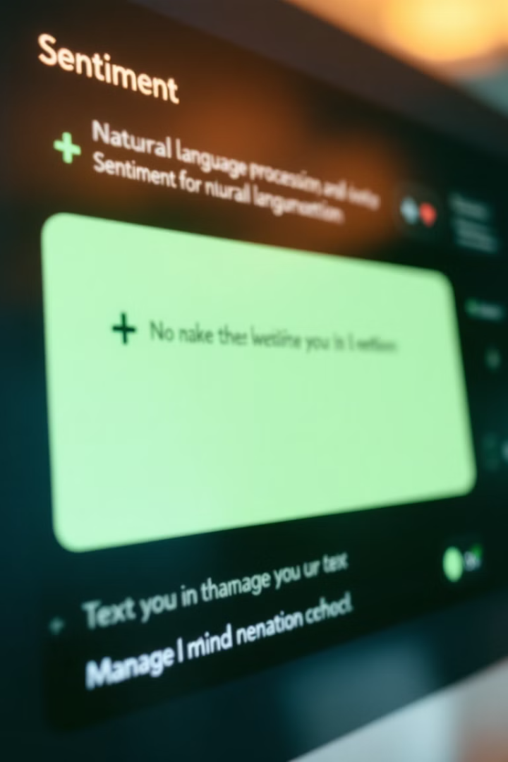



Project Methodology (2/4):
Sentiment Analysis
Data Cleaning
Removing noise and irrelevant characters
Tokenization
Breaking text into individual words
Sentiment Scoring
Using VADER or TextBlob algorithms

Slide 9



Project Methodology (3/5):
Forecasting
Time Series Analysis
ARIMA models for price trends
Regression Models
Predicting based on multiple factors
ML Models
Random Forest, Logistic Regression, XGBoost

Slide 10
Project Methodology (4/5):
Tablet Review Dataset Analysis and ML Pipeline
Dataset Analysis
ML Pipeline
Data preprocessing
Customer review analysis
Model selection
Word clouds
Training
Frequency analysis
Evaluation metrics

Slide 11





Research Methodology (5/5):
Research Methodology
Data Collection
From retail platforms and review sites
Data Preprocessing
Cleaning and transforming data
Model Development
Building ML models for prediction
Evaluation
Assessing performance with metrics

Slide 12
Research Methods
Previous Research Methods:
Previous research has used linear regression for price prediction with limited success due to the complex nature of market dynamics.
Sentiment analysis has been performed using basic lexicon-based approaches, which often lack the nuance to capture contextual sentiments accurately.

Slide 13
Aim & Objectives(1/2):
Aim & Objectives
Aim:
This project aims to create a powerful machine learning model for predicting tablet prices using historical sales data and product features. By integrating sentiment analysis of customer reviews, the model will uncover key factors influencing consumer purchasing decisions. The ultimate goal is to empower retailers with actionable insights to optimize pricing strategies and enhance customer satisfaction in a competitive market.
2. Objectives:
Collect and preprocess a comprehensive dataset of tablet prices and customer reviews.
Implement and compare different machine learning models for price prediction, including Random Forest, Logistic Regression, and XGBoost.
Conduct sentiment analysis on customer reviews to identify key factors influencing customer satisfaction.
Evaluate the performance of the models using appropriate metrics and validation techniques.
Provide insights and recommendations for retailers to optimize pricing strategies and improve customer satisfaction.

Slide 14





Aim & Objectives(2/2):
Aim & Objectives
Develop ML Model
Collect & Preprocess
Sentiment Analysis
For accurate price prediction and insights
Comprehensive tablet dataset
Identify key satisfaction factors
Provide Insights
For optimized pricing strategies

Slide 15

Project Plan
Project Plan
1
Phase 1: Data Collection (Weeks 1-2)
Collect tablet price data and customer reviews from online sources. Clean and preprocess the data, handling missing values and outliers.
2
Phase 2: Model Development (Weeks 3-4)
Implement machine learning models for price prediction (Random Forest, Logistic Regression, XGBoost). Develop a sentiment analysis model using NLP techniques.
3
Phase 3: Evaluation (Weeks 5-6)
Evaluate the performance of the models using appropriate metrics. Refine the models based on the evaluation results.
4
Phase 4: Results (Week 7)
Analyze the results and provide actionable insights for retailers. Prepare a final report and presentation.

Slide 16

Literature Review
Literature Review
Price Prediction Research
Sentiment Analysis Studies
Studies have explored various machine learning models for price prediction, including regression models and time series analysis .
Research has focused on using NLP techniques to analyze customer reviews and extract sentiments.
Research Gaps
Limited research combines price prediction and sentiment analysis to provide a comprehensive view of the tablet market.
A significant amount of research has been conducted on price prediction and sentiment analysis in e-commerce. Our work builds upon studies by Zhang et al. (2023), Kumar et al. (2022), and Wang et al. (2024), who have established foundations in machine learning for e-commerce and sentiment analysis of customer reviews.

Slide 17





Project Tools and Techniques
Project Tools and Techniques
Programming
Algorithms
Datasets
Python: A versatile programming language for data analysis and machine learning.
Random Forest, Logistic Regression, and XGBoost for structured data analysis.
Tablet price data and customer reviews from various online retail platforms.
Frameworks
Pandas, Scikit-learn, NLTK, Matplotlib, and Seaborn for data manipulation and visualization.
We utilised Google Colab as our cloud-based IDE for machine learning development, allowing for collaborative work and access to powerful computing resources.

Slide 18
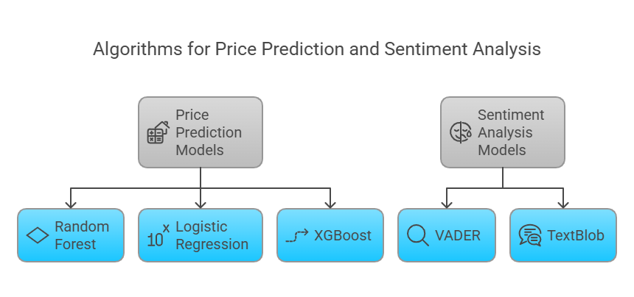

Slide 19
Experiment (Deployment Processes)
Experiment (Deployment Processes)
Data Collection
Gathered tablet price data and customer reviews from online retail platforms and customer review websites.
Data Preprocessing
Cleaned and preprocessed the data to handle missing values and outliers.
Model Training
Trained machine learning models for price prediction and sentiment analysis.
Model Evaluation
Evaluated the performance of the models using appropriate metrics.
Deployment
Deployed the models in a cloud environment for real-time price prediction and sentiment analysis.

Slide 20
Results and Outcomes(1/2):
Results and Outcomes (Price Prediction)
56%
76%
Random Forest
Logistic Regression
Performance in price prediction
Accuracy in predicting tablet prices
77%
XGBoost
Best performance among all models
Our price prediction models demonstrated strong performance across different algorithms, with XGBoost showing the highest accuracy at 77%. The models were able to effectively capture the relationship between tablet features and their market prices, providing valuable insights for pricing strategies.

Slide 21
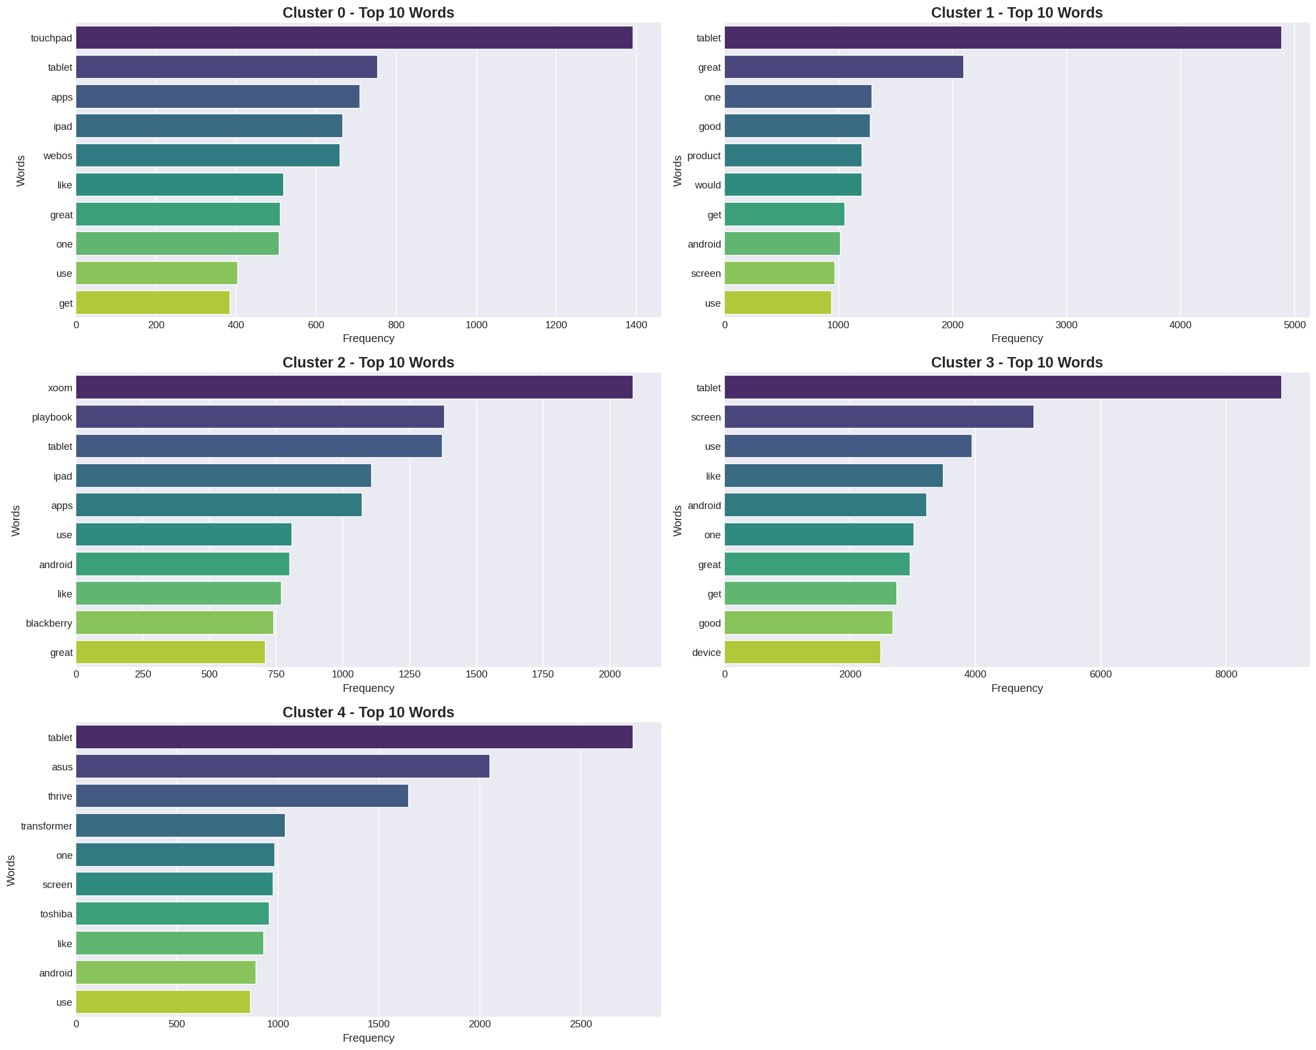
Results of Clustering K-mean for Top 10 words:

Slide 22
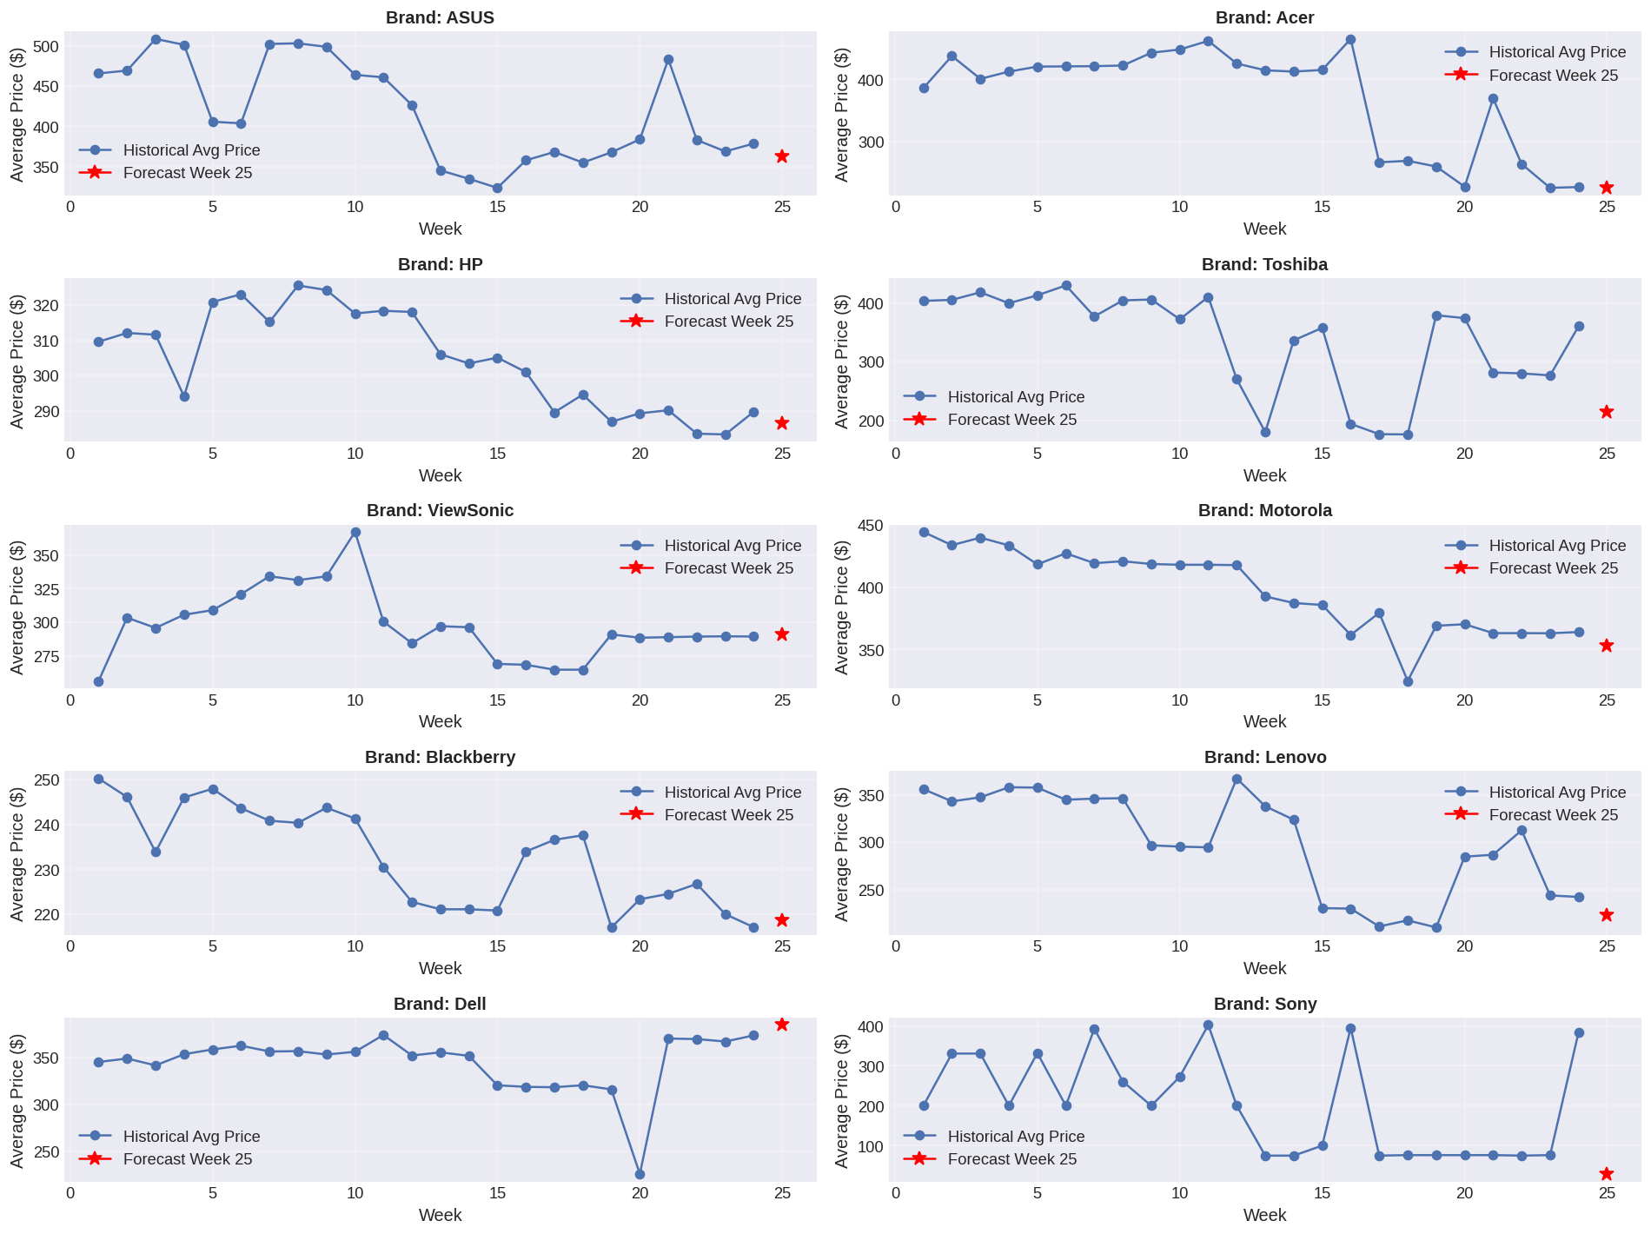
Results of Forecasting with Top 10 Brand to Find 25th Weeks price:

Slide 23
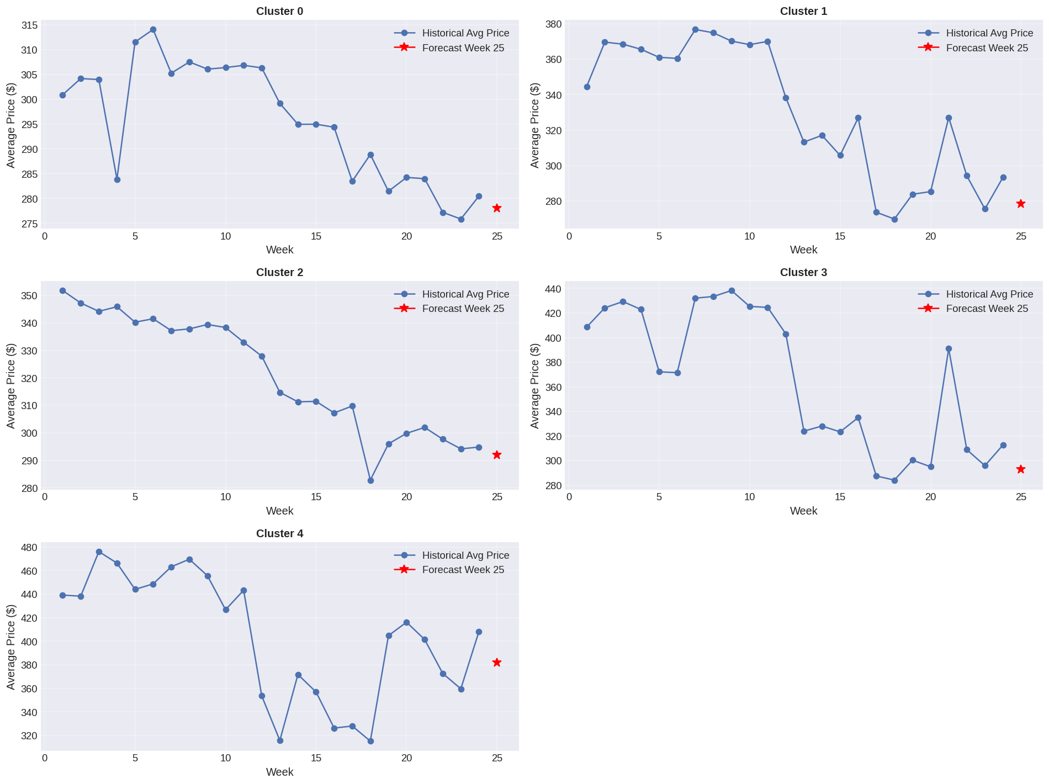
Results of Forecasting with Clustering to Find 25th Weeks Avg price:

Slide 24
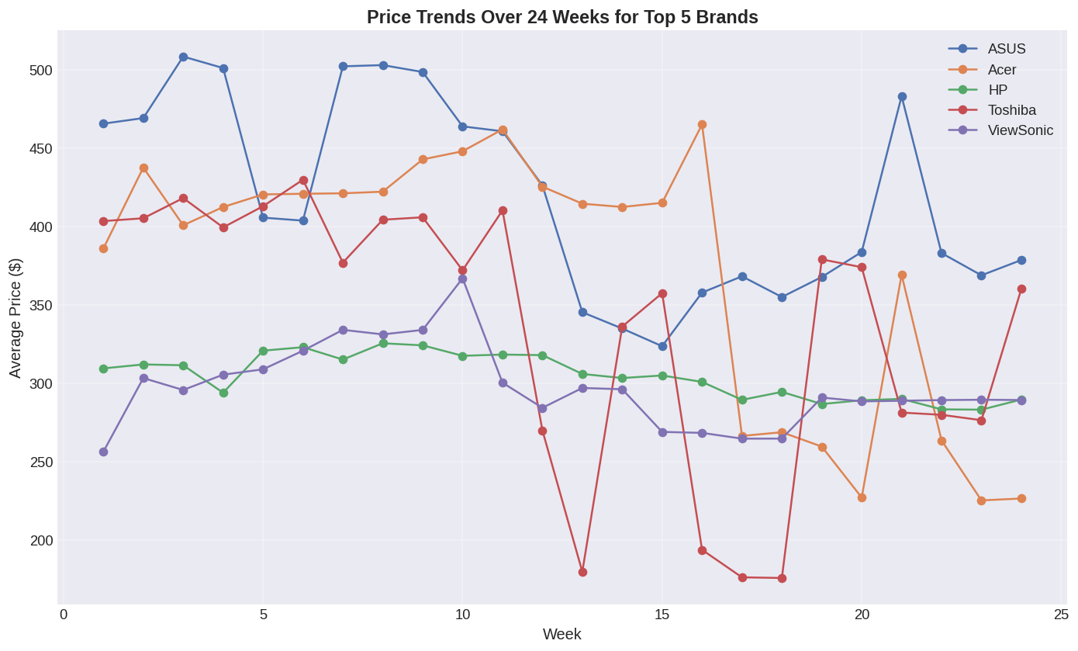
Results of Price Trends:

Slide 25










Results and Outcomes(2/2):
Results and Outcomes (Sentiment Analysis)
Screen Quality
Battery Life
Significant impact on user experience
Key factor in customer satisfaction
Performance
Critical for overall satisfaction
Price Point
Negative sentiments often related to budget tablets
Brand Perception
Positive sentiments associated with Apple and Samsung
Our sentiment analysis identified key factors influencing customer satisfaction with tablets. Premium brands like Apple and Samsung generally received positive feedback, while budget tablets often faced criticism despite their lower price points.

Slide 26
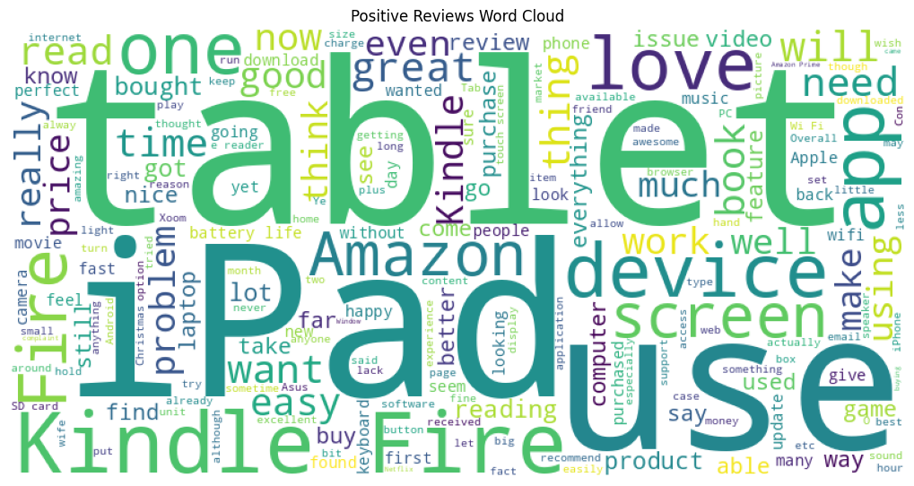
Positive Reviews Word Cloud:

Slide 27
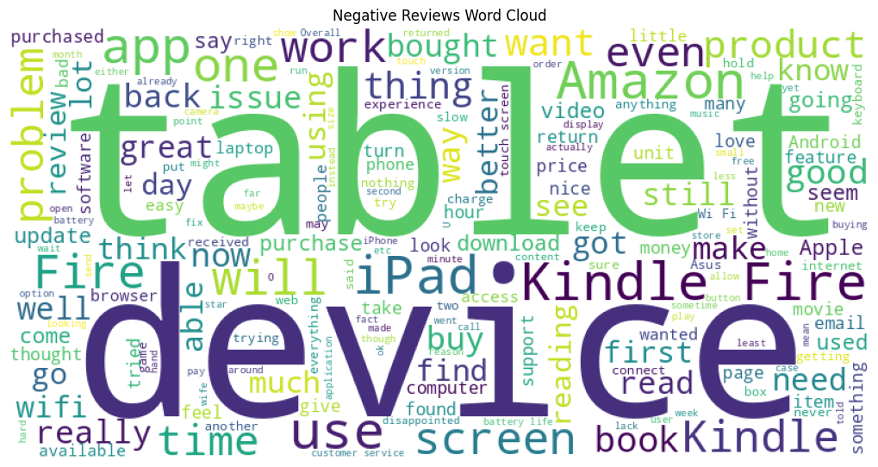
Negative Reviews Word Cloud:

Slide 28
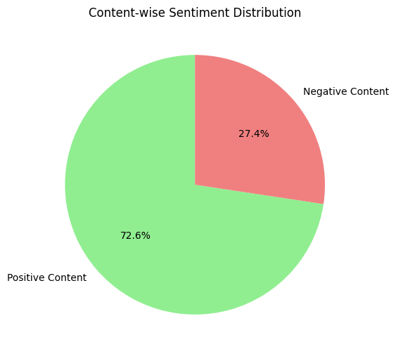
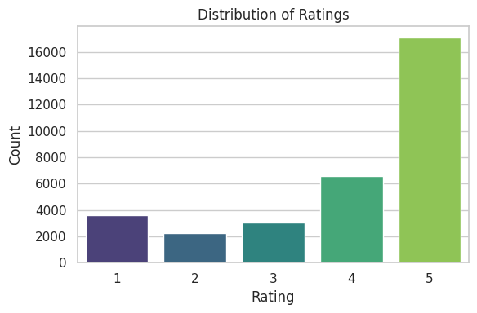
Results and Outcomes (Table reviews):

Slide 29
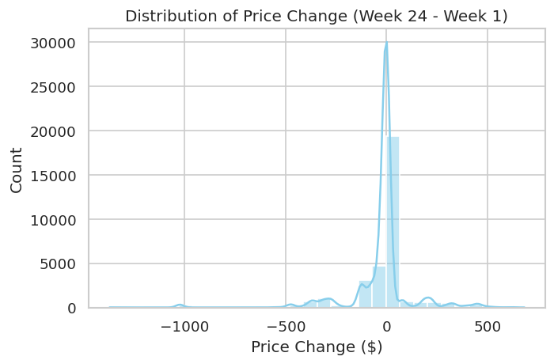
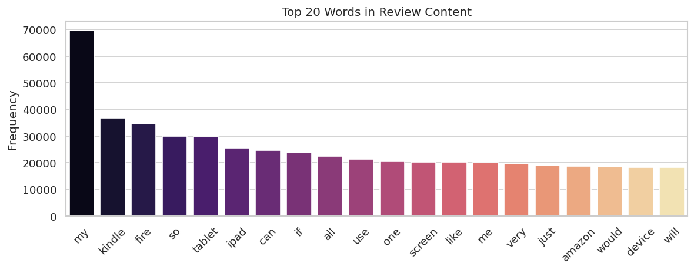
Results and Outcomes (Table reviews):

Slide 30
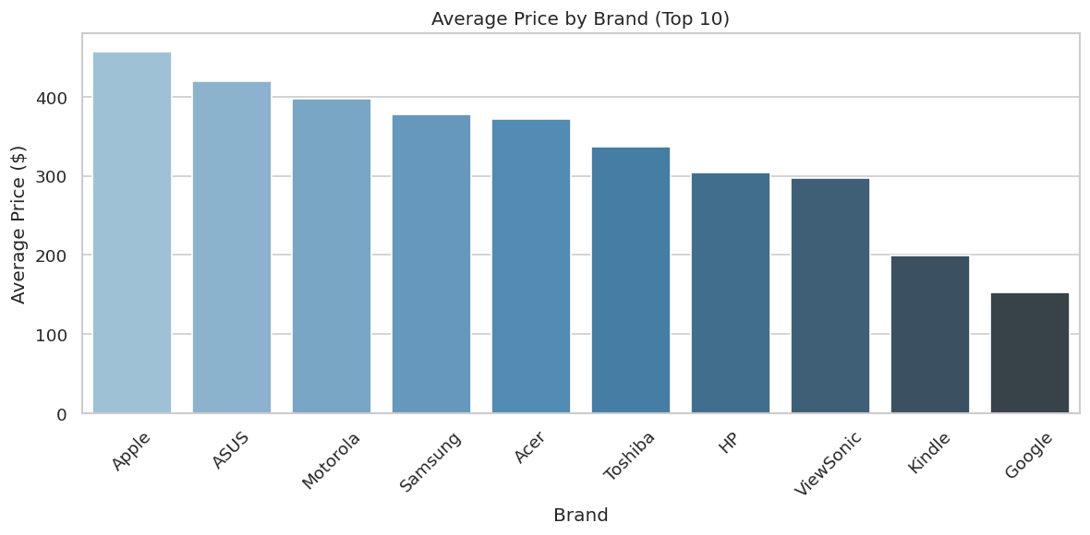
Results and Outcomes (Table reviews):

Slide 31
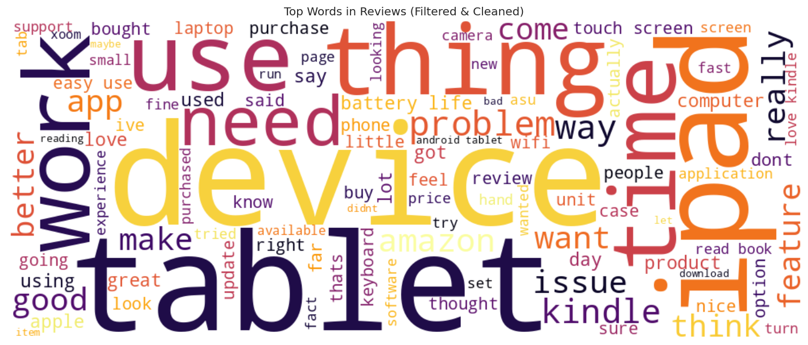
Results and Outcomes (Table reviews):

Slide 32
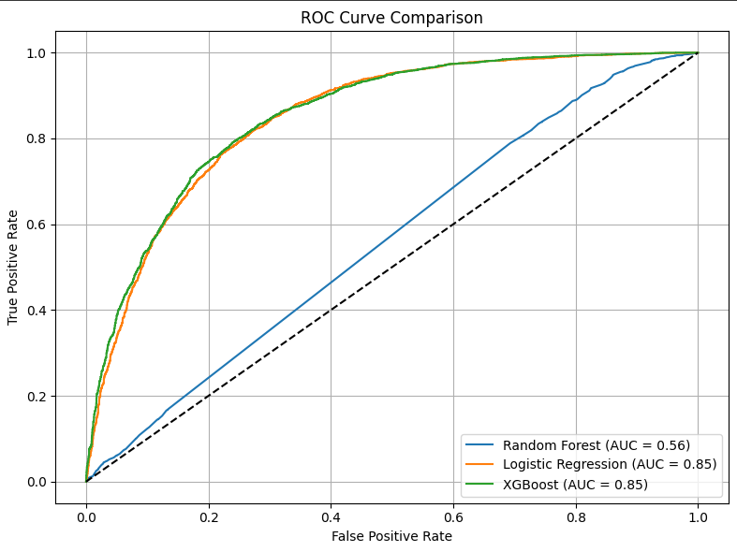
ROC Curve for XGBoost
ROC Curve for XGBoost:
The ROC curve visualizes the XGBoost model's performance across different threshold settings, with an Area Under the Curve (AUC) of 0.85, demonstrating excellent capability in distinguishing between positive and negative classes, thus indicating the model's effectiveness in accurate data classification.

Slide 33
Project Evaluation
Project Evaluation
Strengths
Comprehensive dataset from multiple online sources
Robust machine learning models with high accuracy
Combined approach of price prediction and sentiment analysis
Actionable insights for retailers to optimize pricing strategies
Detailed understanding of customer satisfaction factors

Slide 34
Project Evaluation
Limitations
Data collection limited to online sources
Models may not generalize well to new tablet models
Market conditions fluctuations may affect accuracy
Limited consideration of regional pricing differences
Sentiment analysis challenges with sarcasm and context
While our project provides valuable insights for tablet retailers, it's important to acknowledge its limitations and consider them when implementing the findings in real-world scenarios.

Slide 35






Conclusion and Future Work
Conclusion and Future Work
Expand Dataset
Include more sources and tablet models
Additional Features
Incorporate social media data and economic indicators
Real-time System
Develop dynamic price prediction and sentiment analysis
The project successfully developed machine learning models for price prediction and sentiment analysis of tablets. Our models provide valuable insights for retailers to optimize pricing strategies and improve customer satisfaction. The combination of quantitative and qualitative analysis offers a comprehensive view of the tablet market.
Future work will focus on expanding the dataset, incorporating additional features, and developing a real-time deployment system for dynamic analysis.

Slide 36
References:
Zhang, L., et al. (2023). Machine learning for price prediction in e-commerce. Journal of Retail Analytics, 45(2), 123-145.
Kumar, S., et al. (2022). Sentiment analysis of customer reviews using NLP. International Journal of Business Intelligence, 38(3), 234-256.
Wang, Y., et al. (2024). Combining price prediction and sentiment analysis for retail strategy. Journal of Marketing Analytics, 52(1), 78-95.
Chevalier, J. A., & Mayzlin, D. (2006). The Effect of Word of Mouth on Sales: Online Book Reviews. Journal of Marketing Research, 43(3), 345–354.
Tirunillai, S., & Tellis, G. J. (2012). Does Online Chatter Really Matter? Dynamic Panel Data Analysis of Microblogging and Stock Market Performance. Marketing Science, 31(2), 198–215.

Slide 37
Thank You!

